Slide 1

Notes:
*looks good

Slide 2
Each Speaker Also Shared…
“Here’s what we don’t know how to do…”
“Here’s what we’re looking for help with...”

Slide 3
Year 2: DevOps Enterprise Summit
Automated testing
Culture and leadership in transformation
Organizational design, roles, and responsibilities
Information security and compliance practices
Identifying metrics to drive improvement goals

Slide 4
Year 3: DevOps Enterprise Summit
Leading change
Modern architectural and technical practices for leaders
Designing our organization
Bridging the information security and compliance gap

Slide 5
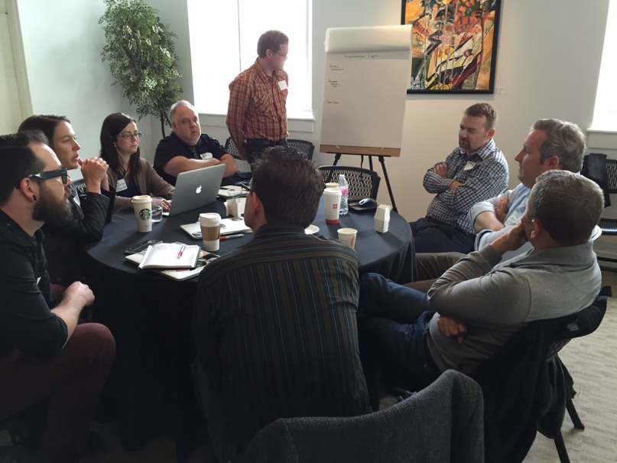
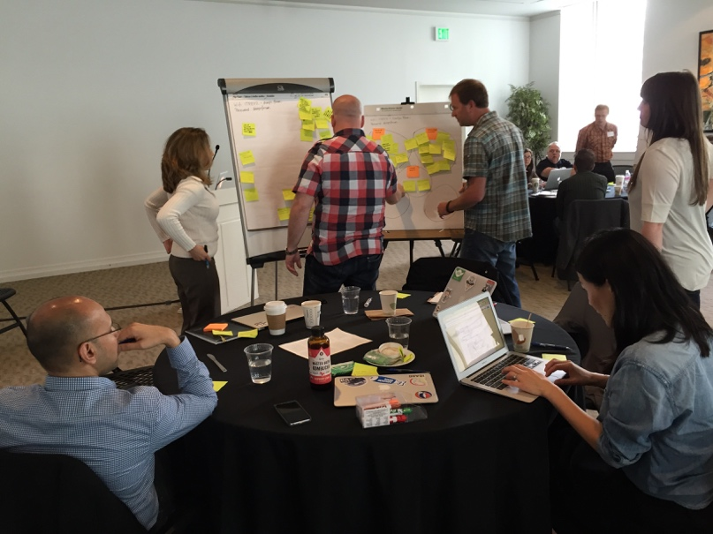
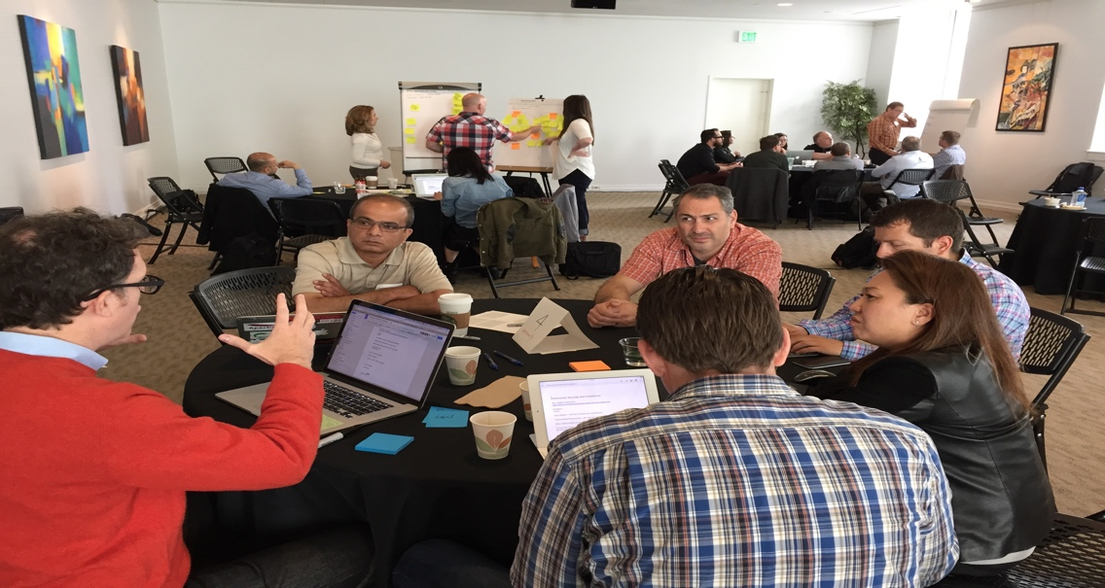
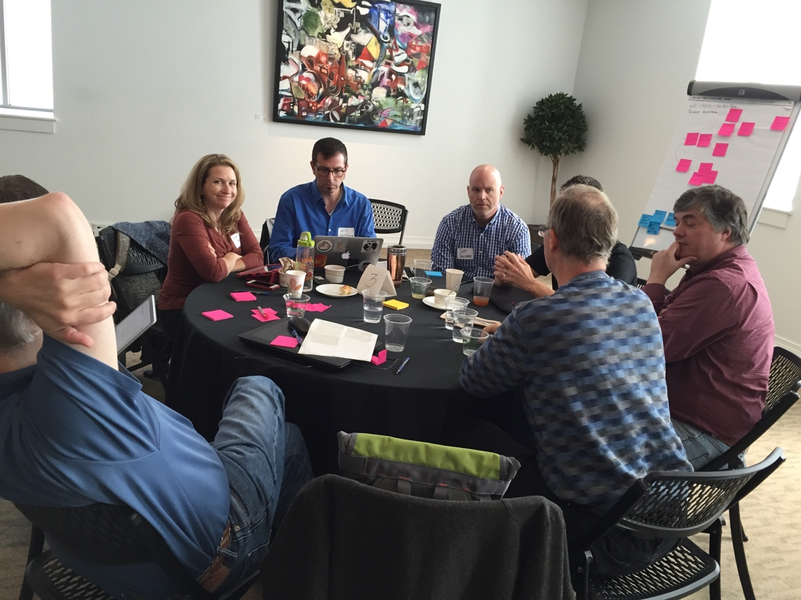
Notes:
I’ve asked every speaker to end with a slide with one of 2 titles: “here’s what I don’t know how to do” or “here’s what I’m looking for help with”
In addition to getting those experts to speak here, we invited 35 of the contributors from last year to help generate written guidance. One of my favorite lines from "The Phoenix Project” is this: “Messiahs are great, but Scripture is better.”
Our ask was simple: come spend 3 days in Portland, and let’s divide up into 5 teams of fellow leaders and practitioners to generate written guidance for the community
And holy cow, did they ever deliver.

Slide 6
Mutually Exothermic
A Community That Is Helping Each Other
Notes:
So here’s my conjecture: <CLICK>
Larger organizations have more to gain
I genuinely believe that the vast majority of economic value by DevOps won’t be in the unicorns of Googles, Amazon, Netflix… Instead it will be created by organizations that look like you, from the rise of the “horses.” Why? First off, that’s where the majority of technology spending occurs, and more importantly, that’s where the majority of the technology workforce is — in the large, successful organizations spanning every industry vertical.

Slide 7
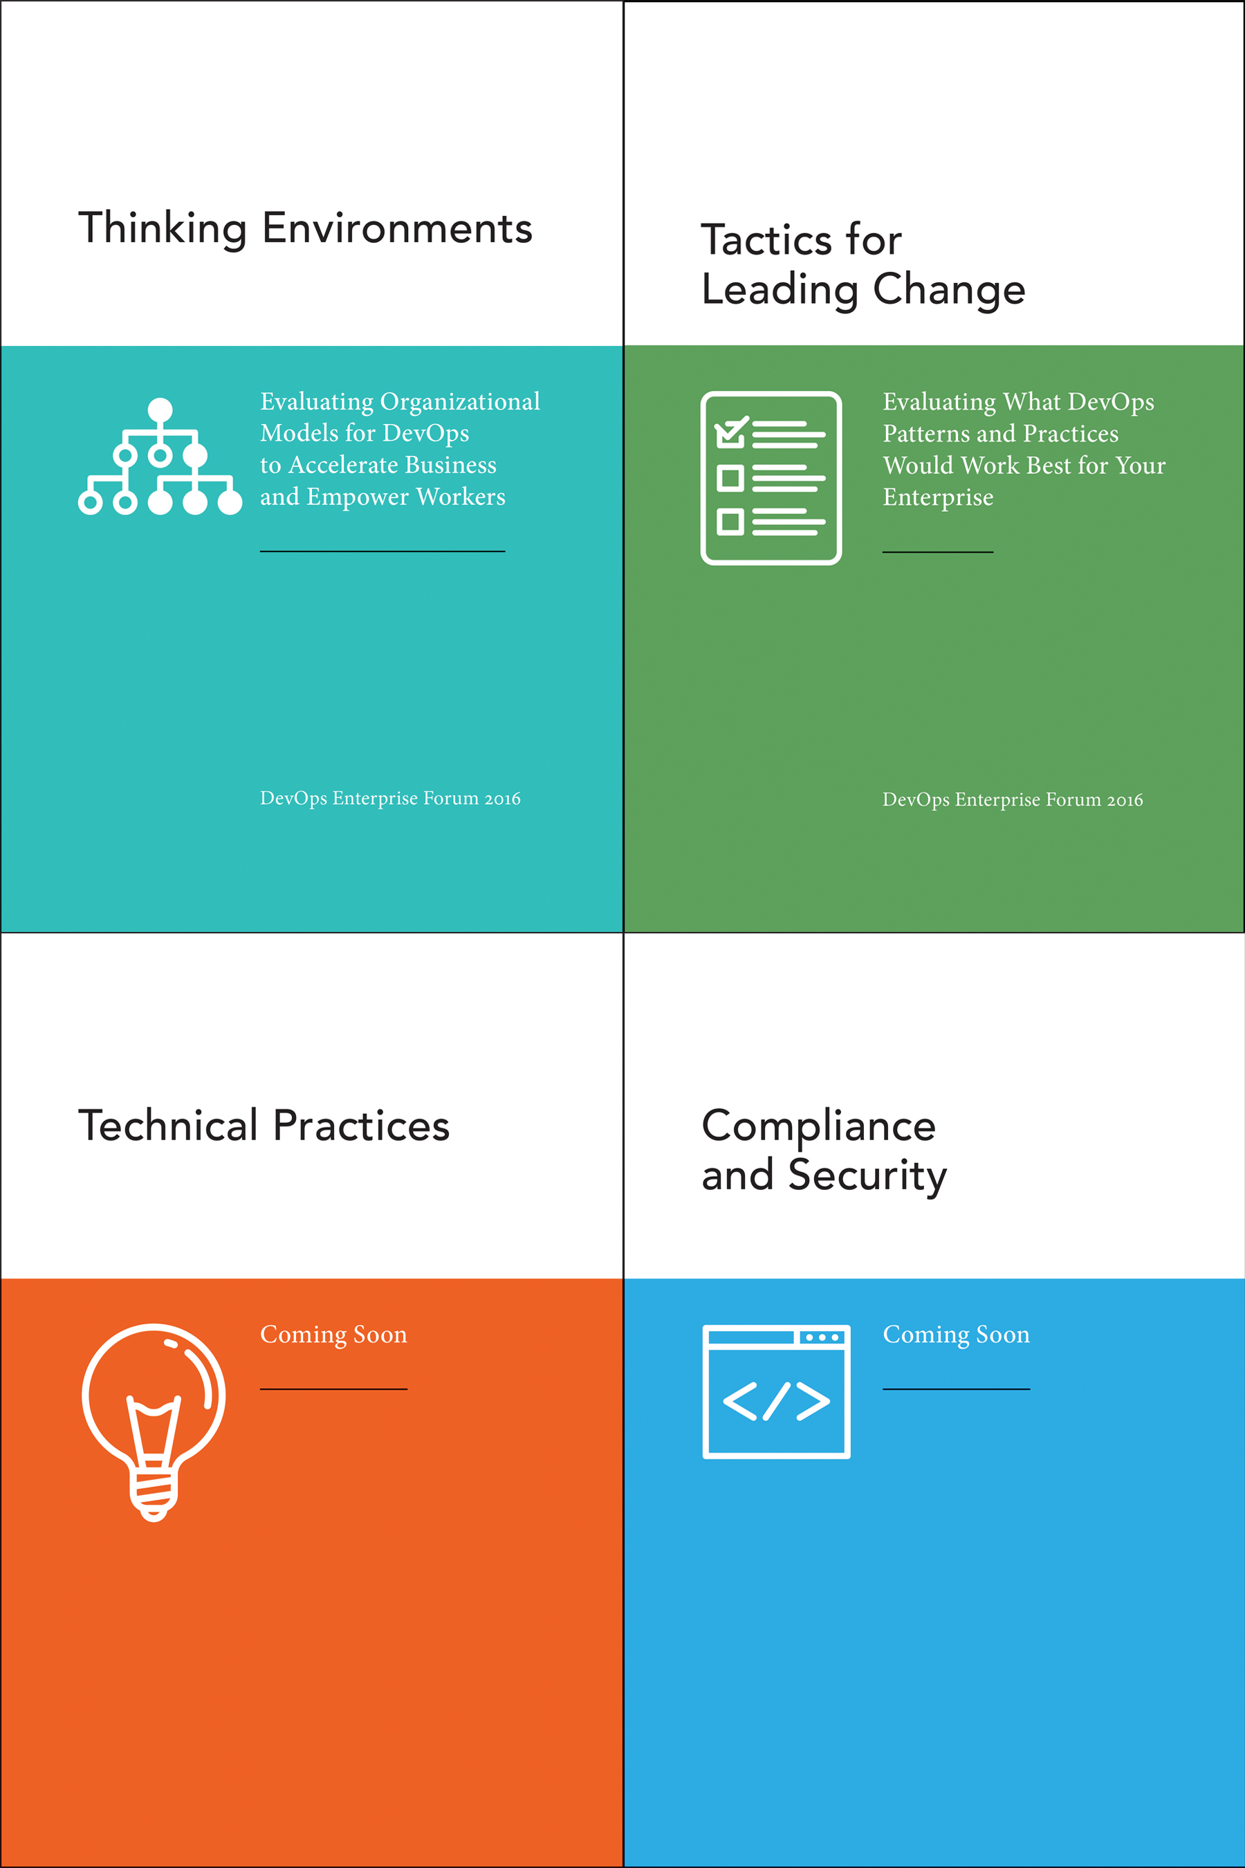
DevOps Enterprise Forum
Download the eBooks
bit.ly/devopsforum
Notes:
Each group leader will tell us in 3-4 minutes: <<< please give each speaker 3.5 min
What problem they set out to solve
What they did
And why you should attend their DevOps Workshop

Slide 8
Organization Design
Today
1:15pm– 2:15pm
Imperial A

Slide 9
Security
Today
2:25pm– 3:25pm
Imperial A

Slide 10
Leading Change
Tuesday
10:55am– 11:55am
Imperial A

Slide 11
Modern Technical Practices
Tuesday
1:25pm– 2:25pm
Imperial A

Slide 12
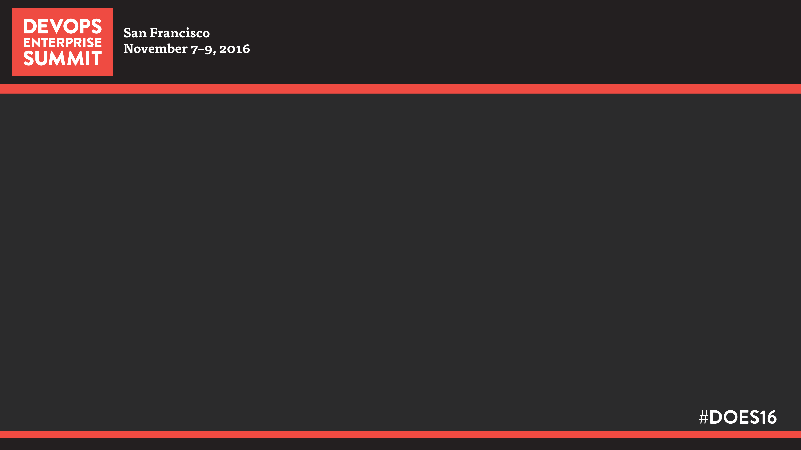
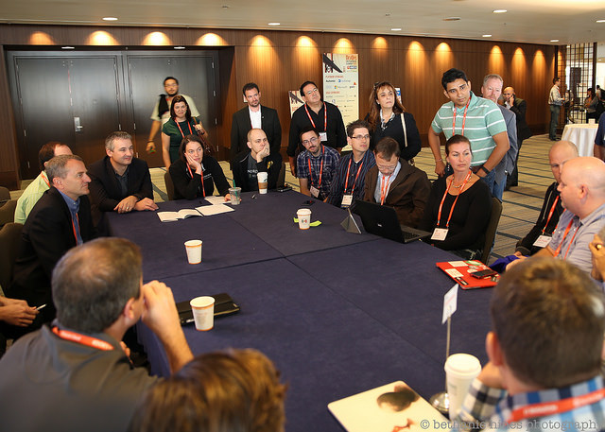
DevOps Workshops Imperial A
Leading Change
Organizational Design
Modern Technical Practices
Security & Compliance
2 Unstructured Open Workshops
Notes:
DevOps Workshop photo

